Slide 1
Travel Expert’s App Demo
Powered By: BAG Solutions

Slide 2

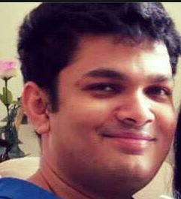

About BAG Solutions [BAGS]
Brodie Zoschke B
Best Boss
A Anushka De Silva
Awesome Boss
Garret John G
God Boss

Slide 3
Project’s Scope
Allow entry/edit of Travel Packages and Agents in a Graphical User Interface Application
Allow Travel Expert’s Customers to View their Travel Packages and Edit Customer’s Information

Slide 4
Solutions offering by BAG Solutions
JAVA Graphical User Interface (GUI) Application for Travel Expert’s Agents
Add/ Edit Travel Expert’s Packages
Add/ Edit Travel Expert’s Travel Expert’s Agents
Set Customers to a New Agent when existing Agent become Inactive
Add/ Edit/ Delete Travel Expert’s Customers [Added Extra Feature]
JSP Web- Based Application for Travel Expert’s Customer
Edit Travel Expert’s Customer Information by Customer
View Customer’s Package Details
Android Mobile Application for Travel Expert’s Customer [Added Extra Feature]
View Customer’s Package Details

Slide 5
DEMO
JAVA Application
Android Application
JSP Web-Based Application

Slide 6
Time Scheme And Cost For This Proposed Application
Software Development Stage | Duration
Analyze | 6 Weeks
Design | 3 Weeks
Develop | 6 Weeks
Testing | 3 Weeks
Finalize | 1 Week
Total Time | 19 Weeks
This Application Costs CDN $ 50,000/=

Slide 7
Questions ? ?
Thank You ! !

